Slide 1


Bias vs bias – dawn of justice: a fair fight in recommendation systems fairness-aware movie recommendation system
By Michael antoniades

Slide 2
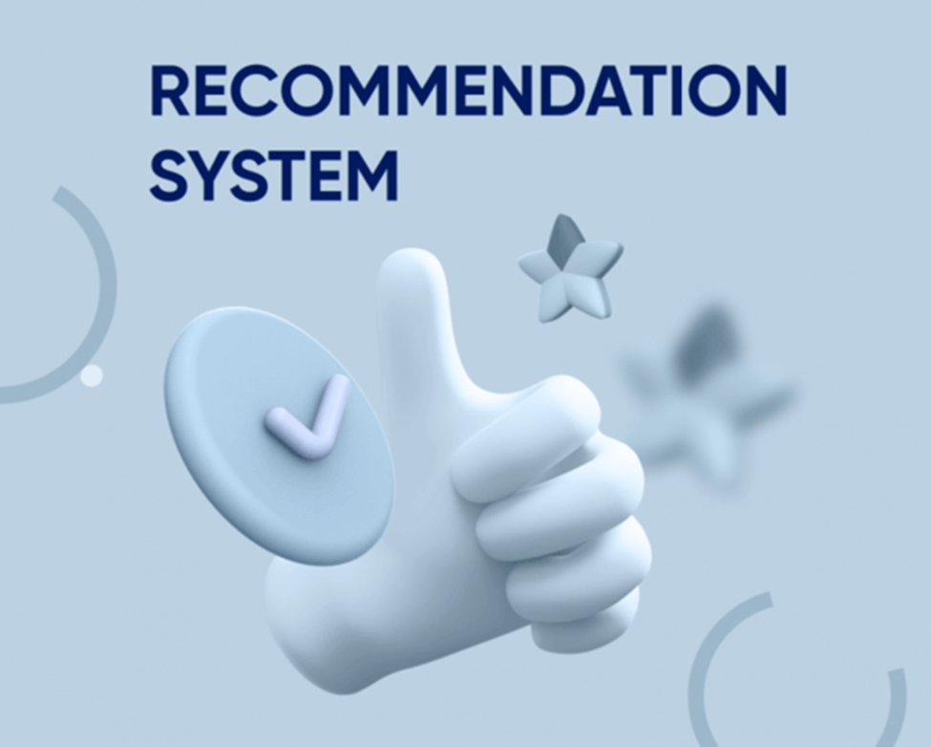
INTRODUCTION
Built a movie recommender system using MovieLens-style data.
Studied the balance between recommendation accuracy and fairness.
Applied fair re-ranking, adaptive fairness and runtime optimization.

Slide 3
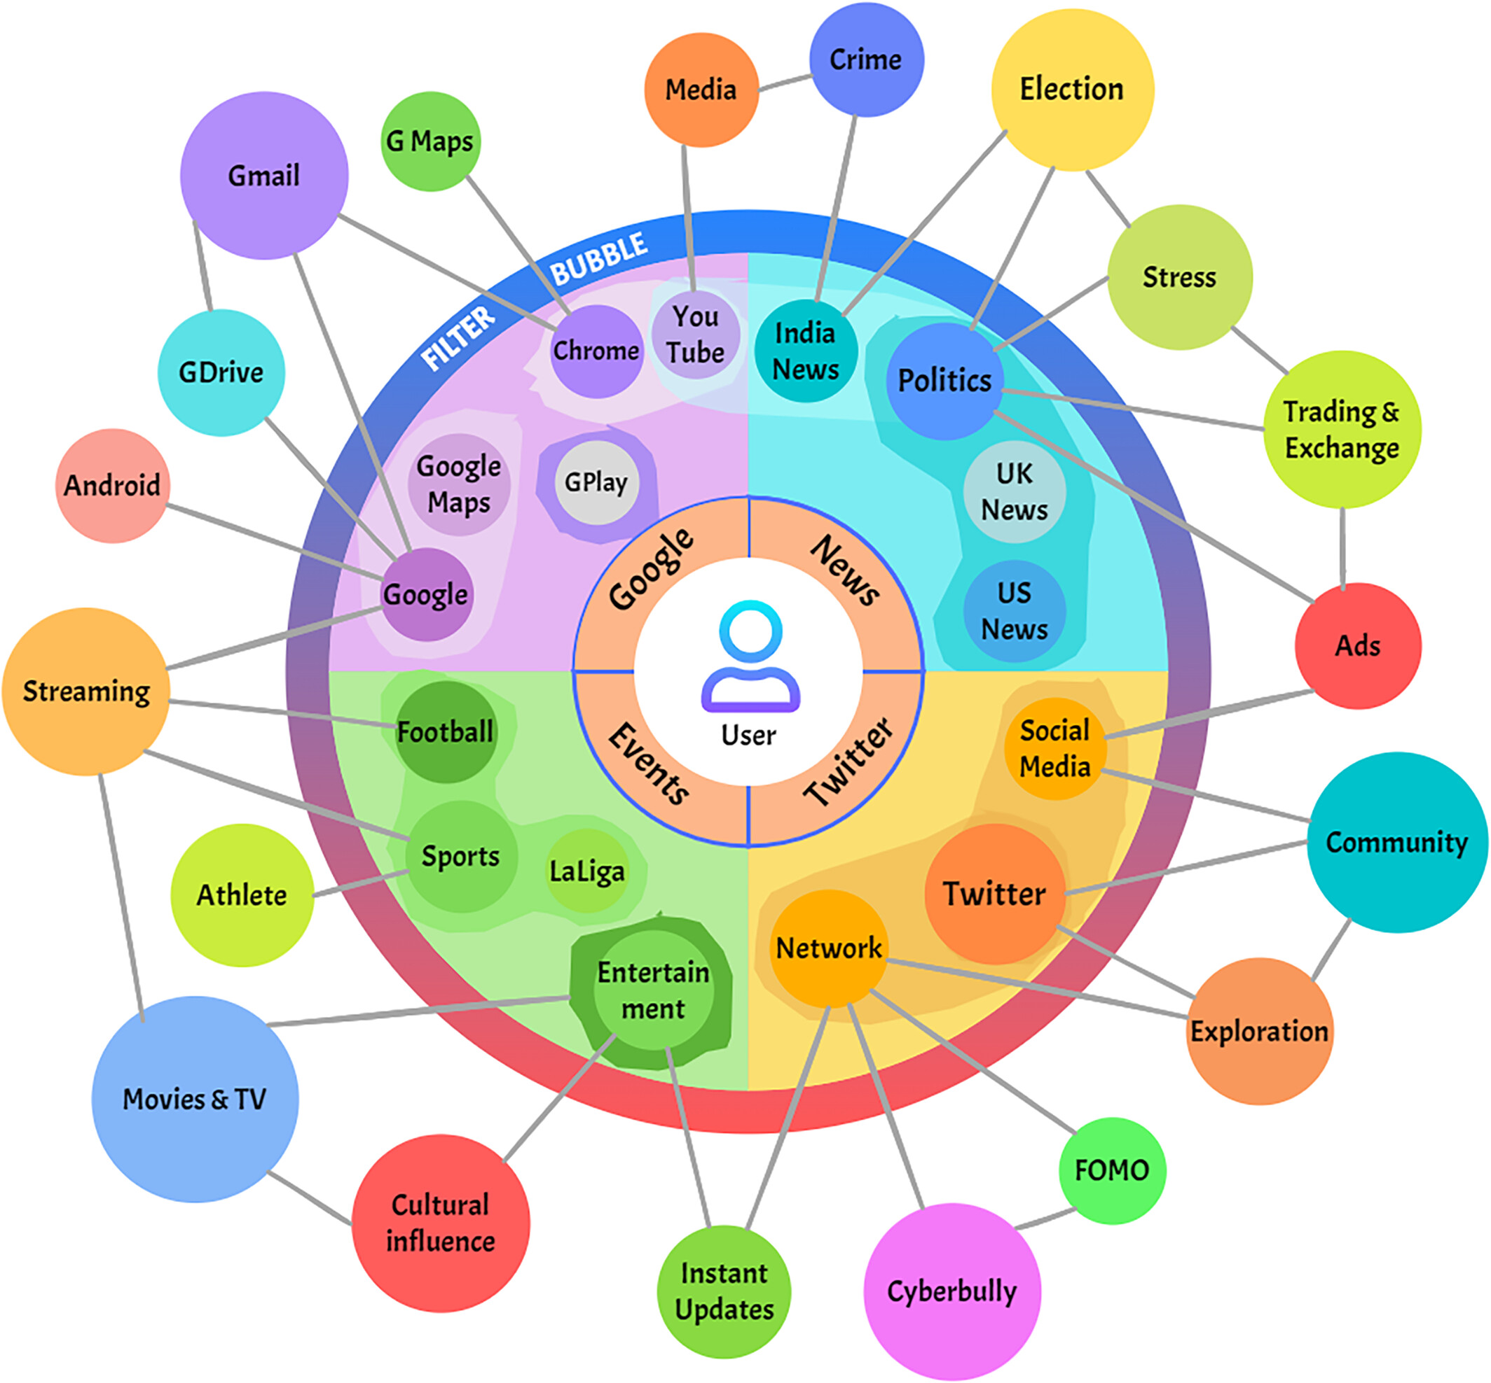
Problem Motivation
Recommender systems suggest movies, music, products and content every day.
Accuracy-focused systems can reproduce demographic bias.
The goal is to reduce unfair recommendations without losing quality.

Slide 4
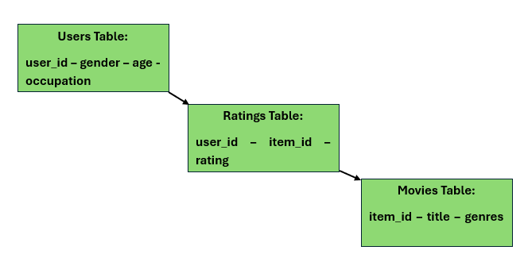
Dataset & Pipeline
The dataset contains users, ratings and movies.
User attributes include gender, age and occupation.
Movie genres are converted into binary vectors for fairness analysis.

Slide 5
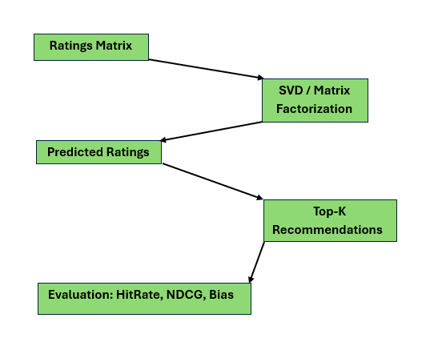
Baseline Recommendation Model
The baseline uses collaborative filtering with SVD.
It predicts missing user-movie ratings.
It recommends the Top-K movies with the highest predicted scores.

Slide 6
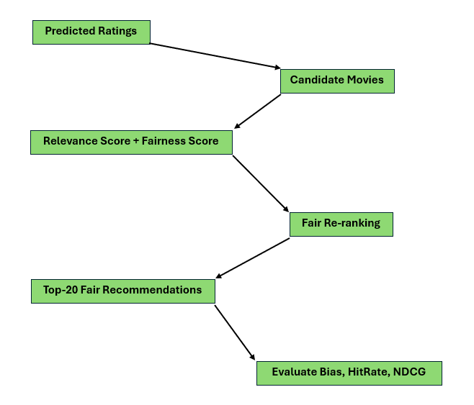
Fairness-Aware Re-Ranking
RCP measures the genre distribution of recommended movies.
CCP represents the fair target distribution.
KL-Divergence measures how biased the recommendations are.

Slide 7
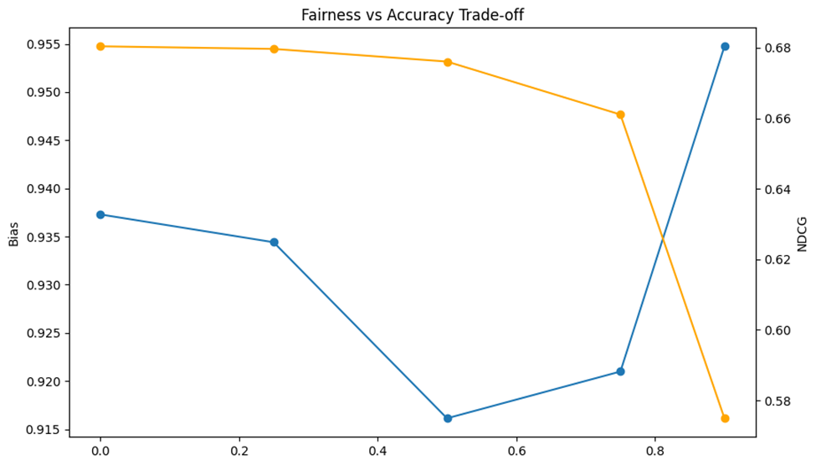
Bias-Accuracy Trade-Off
β controls the balance between relevance and fairness.
β = 0.5 gave the best balance in our experiments.
Very high β reduces HitRate and NDCG because fairness dominates relevance.

Slide 8
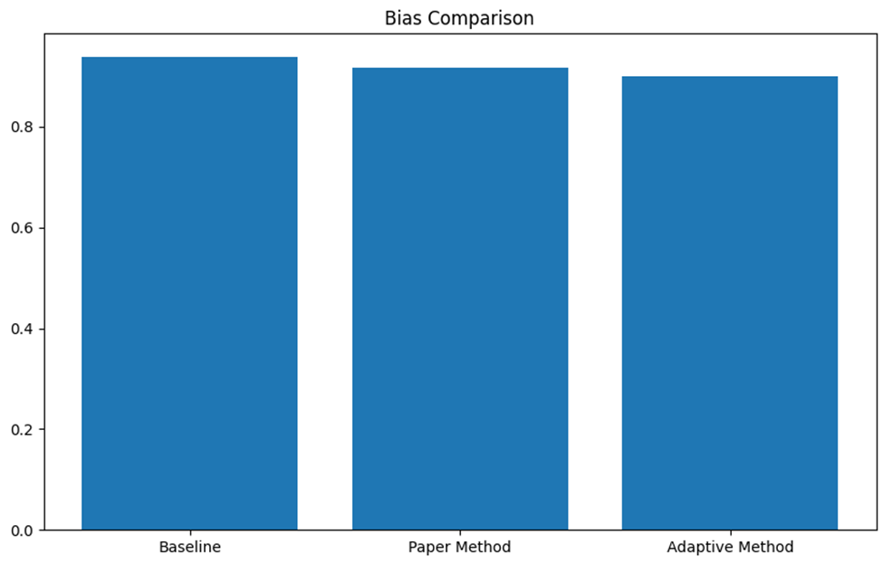
Adaptive Fairness Method
Instead of one β for all users, each user gets a personalized β.
1
Users with higher bias receive stronger fairness correction.
2
Adaptive fairness achieved the lowest bias: 0.899.
3

Slide 9
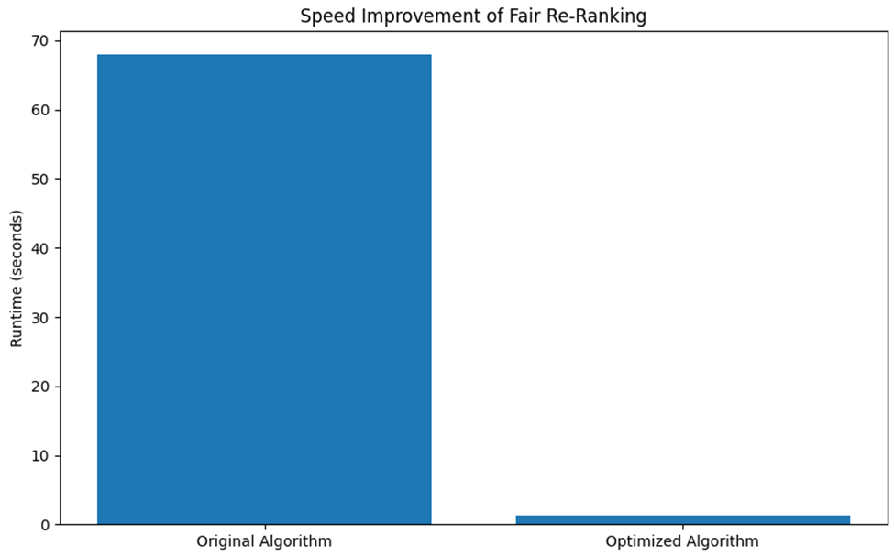
Runtime Optimization
The original fair method used slow loops over users and movies.
The optimized version uses precomputed matrices and NumPy vectorization.
Runtime improved rom 67.94 s to 1.24 s with the same results.

Slide 10
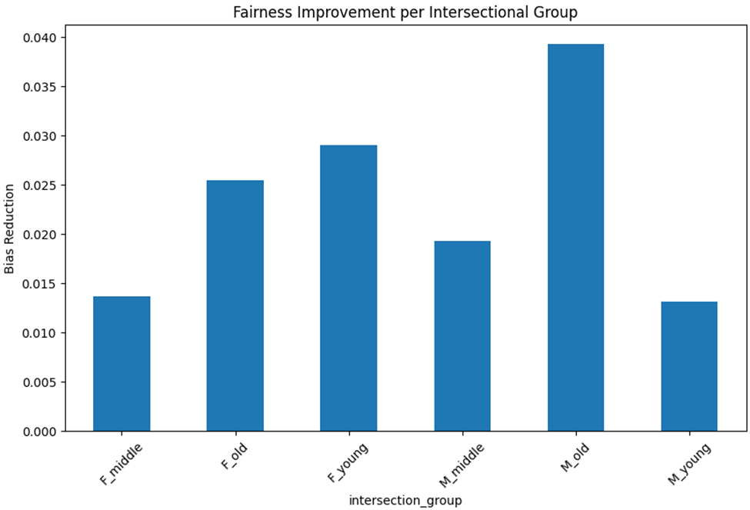
Robustness Experiments
Fairness was tested across active/inactive and cold-start users.
Intersectional groups were evaluated using gender x age.
The method reduced bias across groups, but cold-start users remained harder.

Slide 11
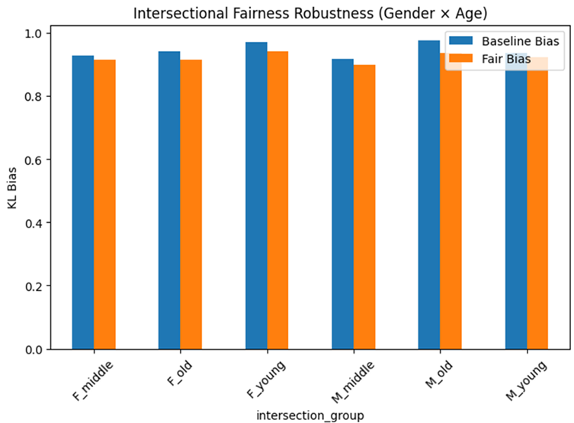
Final Evaluation & Conclusion
Fair re-ranking reduced bias while keeping accuracy almost unchanged.
Adaptive fairness gave the best fairness score.
Optimized fair re-ranking made the method practical and much faster.

Slide 12
Final Table
Method | HitRate | NDCG | Bias | Runtime
Baseline | 0.957 | 0.680 | 0.937 | ~0
Fair Paper Method | 0.955 | 0.676 | 0.916 | 67.94 s
Adaptive Method | 0.958 | 0.680 | 0.899 | 94.46 s
Optimized Fair | 0.955 | 0.676 | 0.916 | 1.24 s

Slide 13


Slide 14
References
https://www.google.com/search?sca_esv=525e608177515078&rlz=1C1GCEA_enGR1136GR1136&sxsrf=ANbL-n4Sc4ul-RbthOP-o5ombGYV1lXTQA:1779439797802&udm=2&fbs=ADc_l-acTh1XOpH3U7bIxRVfQR5uwuYj4r9gy2Evo0qcadc4dYDkhazAPtodrn_bK51i8Y4iddj5h50cwAlx0WFGTaviF3MURLTpSAjZ1wylooHX2xAp_nqr934Q0t9_fKc93Ruvn5f5x60KDdLB8BtCMyIw1-3SoGXMea_8QyS9Dm0vrOoKcjsSSCnys6bbaZhMu6Gmy2SjfYUG_cIZHW263w7cYJoZF3hunJJ9WDIfSw-H9puTwA4&q=biased+recommendations+or+user+groups+separated+into+bubbles&sa=X&ved=2ahUKEwiEirDowcyUAxV7cfEDHUhJOw8QtKgLegQIFxAB&biw=1043&bih=903&dpr=1#sv=CAMSVhoyKhBlLTdlUkhDeVpONmdobnFNMg43ZVJIQ3laTjZnaG5xTToObFZ6SHY4aE0ydTlCUU0gBCocCgZtb3NhaWMSEGUtN2VSSEN5Wk42Z2hucU0YADABGAcgh4O77AFKCBABGAEgASgB
https://www.google.com/search?sca_esv=c002384ed01e5123&rlz=1C1GCEA_enGR1136GR1136&sxsrf=ANbL-n7ww0z9-_KSuZ49-s1QqwqzAUBdBg:1779280913894&udm=2&fbs=ADc_l-acTh1XOpH3U7bIxRVfQR5uwuYj4r9gy2Evo0qcadc4dYDkhazAPtodrn_bK51i8Y7EC5aI0ML9l7g2bNsr7sxGhBjXBZVkh_olIjcdf5JAAmrbQlExY9L-PIiYAjuz1hlDHSln83QSjPQeG3Wvpd3AF5b6EyVa5QVr0n-MgF4HlSnlRJbUk4rNiLx0b3t-nv8m1jJDz_Sid6WndCJlwZ2jsQTAFSsOeGDTuLShs0DDIZel8lk&q=recommendation+systems&sa=X&sqi=2&ved=2ahUKEwiu6M_28ceUAxUdJBAIHexJIpsQtKgLegQIKhAB&biw=1920&bih=911&dpr=1#sv=CAMSVhoyKhBlLWJLLTlSZnd3cFI2SnhNMg5iSy05UmZ3d3BSNkp4TToOR0VFdktldERjTTJ0NU0gBCocCgZtb3NhaWMSEGUtYkstOVJmd3dwUjZKeE0YADABGAcgx6aA8AVKCBABGAEgASgB
https://arxiv.org/abs/2506.18327

